Slide 1

Customer Relationship Management
C r m application to improve Business Relations

Slide 2
Storage of customer Data Customer Interactions Analysis of Customer Data Customer Feedback
What IT solves.?

Slide 3
What are the features we provide
Contact Management
Sales Automation
Marketing Automation
Lead Management
Customer Service and Support
Analytics and Reporting
Mobile Access

Slide 4



1.Contact Management
Storing contact information.
Customer Interactions details
2.Lead Management
Tracking and Capturing main good relationship through sales pipeline.

Slide 5
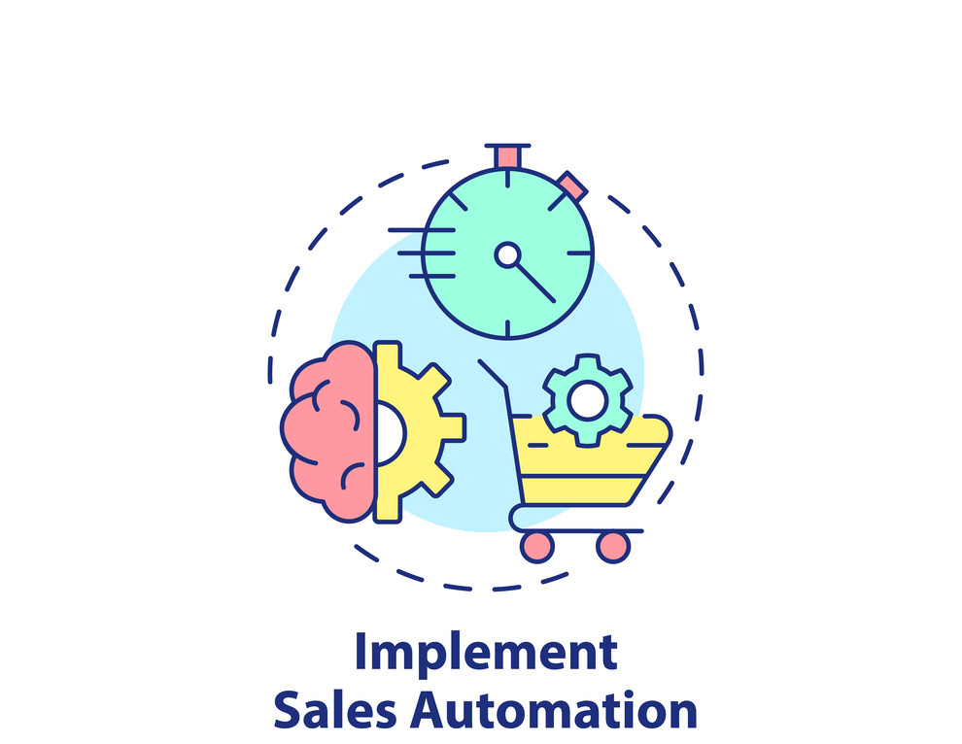

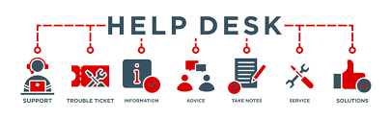
3.Sales Automatiion
Automation of repetitive tasks like follow-up emails and scheduling appointments.
4.Customer Service and Support
Ticket Management System (managing customer inquires & requests)

Slide 6



5.Analytics and Reporting
Dashboard with realtime insights.
Visualizations for analysis.
6.Mobile Access
Supports for mobile devices.
Responsive design for every device.

Slide 7

7.Customised Software
According to the requirements we provide the customisable software.

